Slide 1

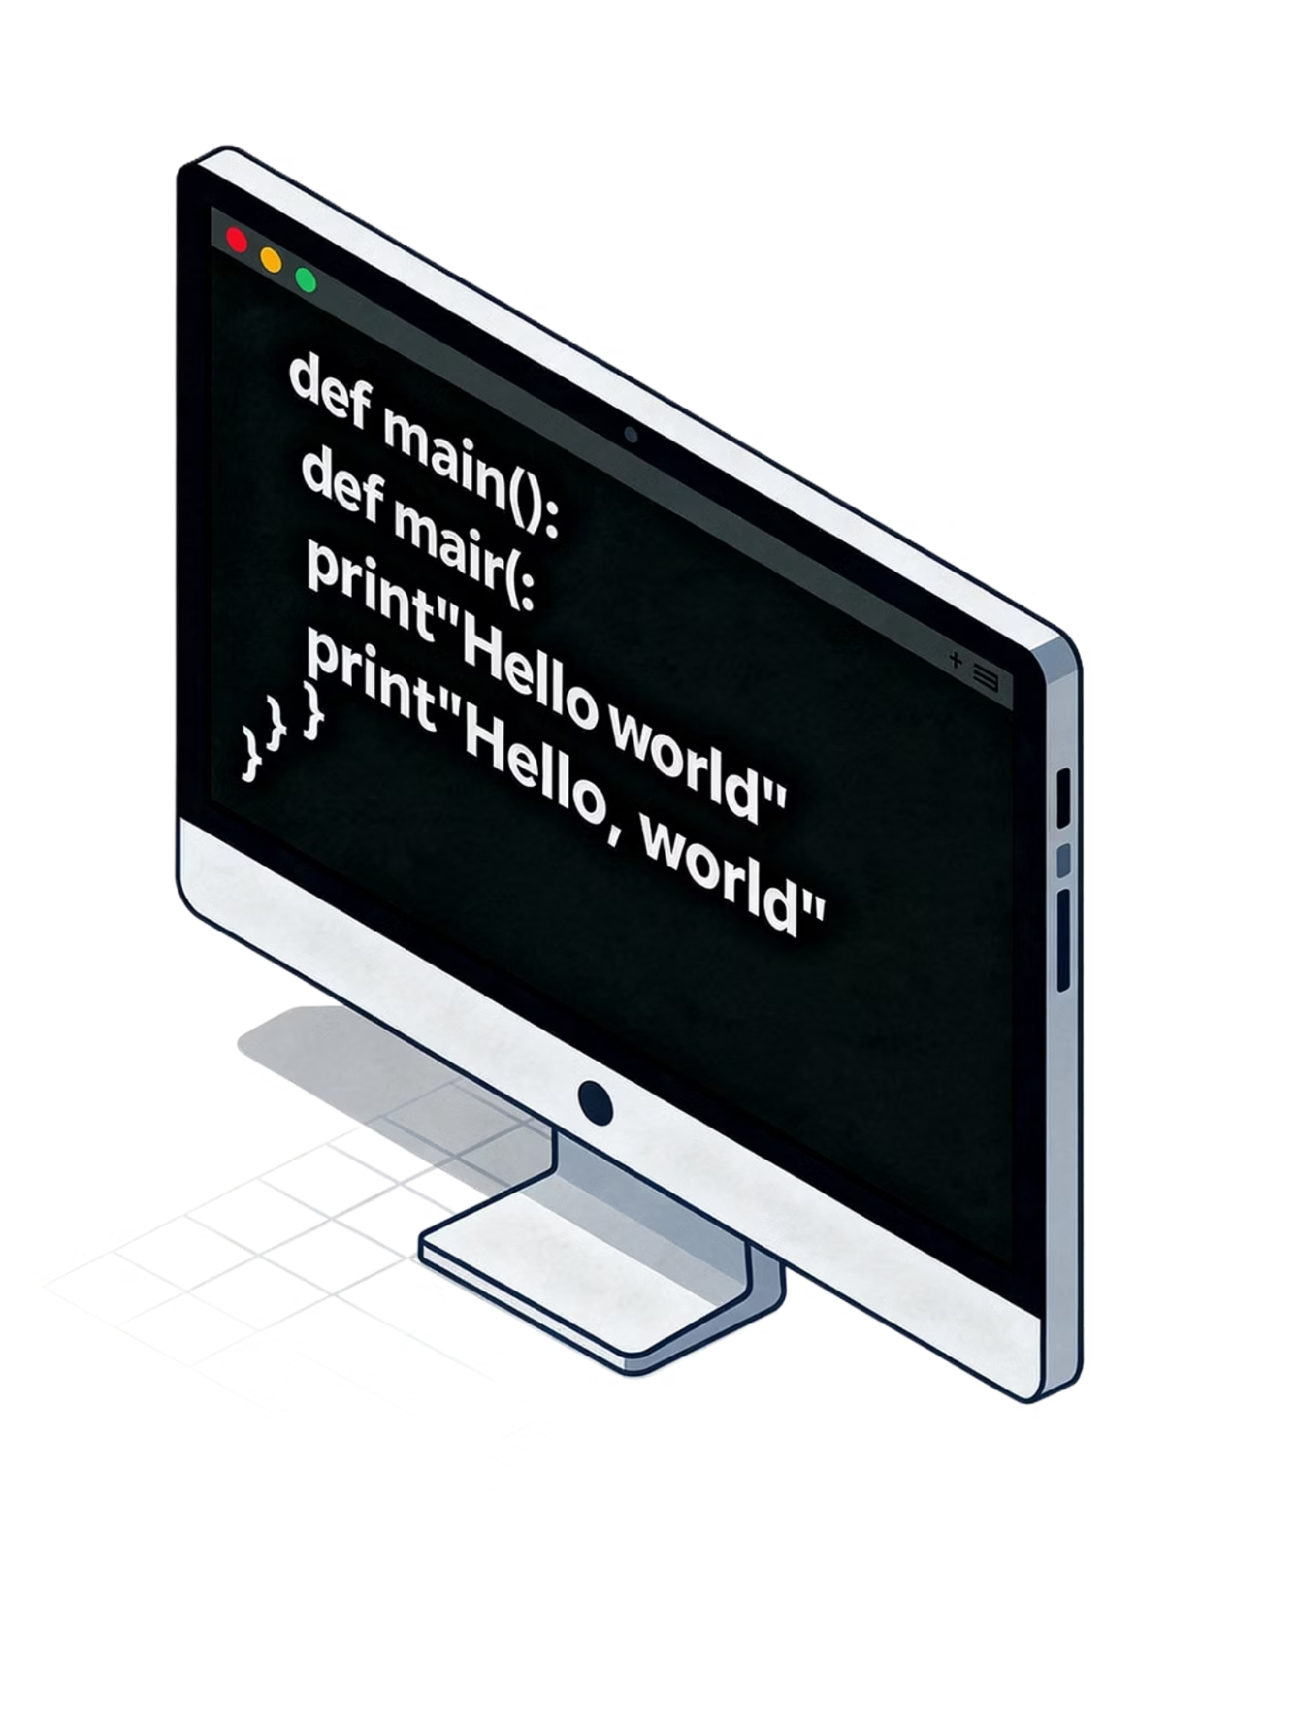
Types of Operators in Python
A beginner-friendly guide to all 6 main operator types — with clear examples and code snippets.

Slide 2
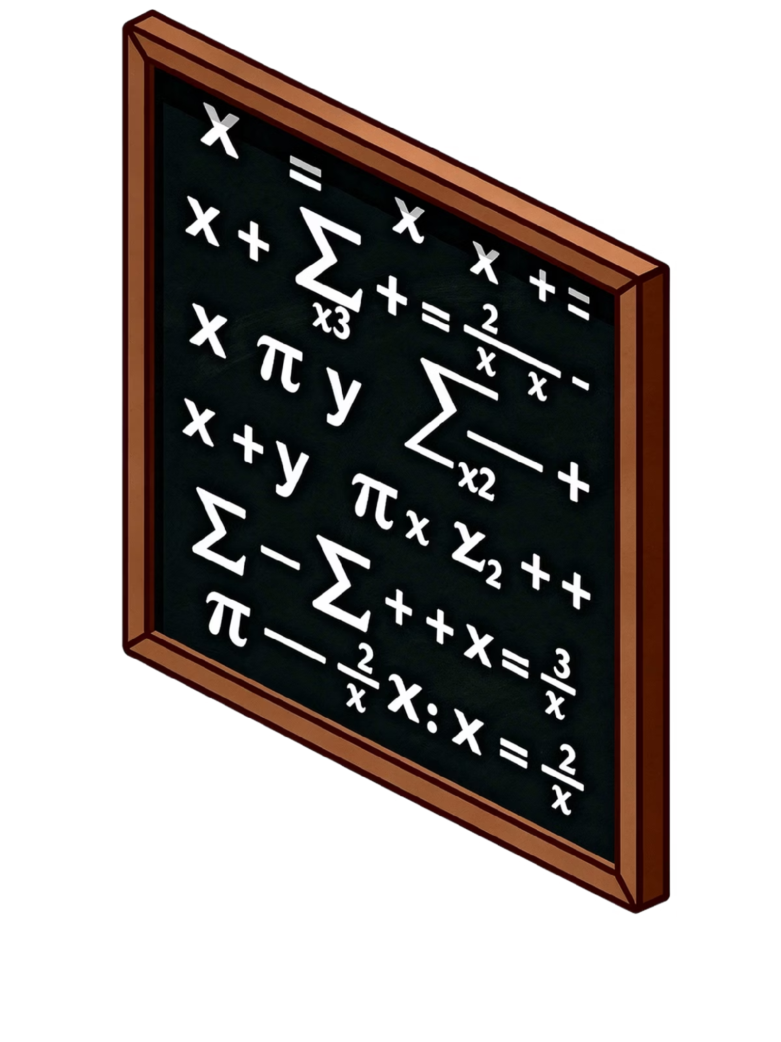
What Is an Operator?
Operators are special symbols that perform operations on values and variables. Python groups them into 6 main types.
Operands
Expression
The values an operator acts on.
A combination of operands and operators that produces a result.
5 + 3
# 5 and 3 are operands
# + is the operator
result = 5 + 3
# This is an expression
# result = 8

Slide 3



Arithmetic Operators
The building blocks of mathematical computation in Python.
Basic: +, -, *, /
Floor Division: //
10 + 3 # 13
10 - 3 # 7
10 * 3 # 30
10 / 3 # 3.333...
7 // 2 # 3
# Drops the decimal,
# returns whole number
Modulus: %
Exponentiation: **
7 % 2 # 1
# Returns the remainder
# after division
2 ** 3 # 8
# 2 raised to the
# power of 3

Slide 4
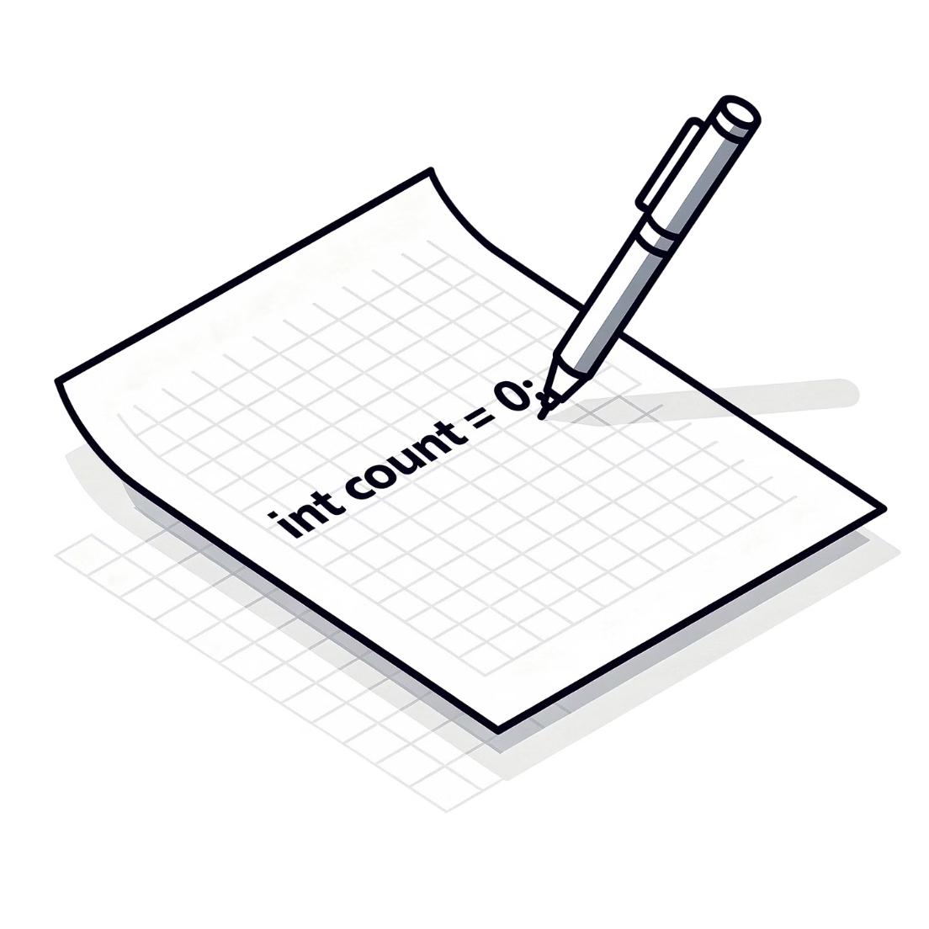
Assignment Operators
Assignment operators store and update values in variables efficiently.
= — Assigns a value: x = 10
+=, -=, *=, /= — Shorthand for updating a variable
//=, %=, **= — Compound assignment for floor division, modulus, and exponentiation
x = 10
x += 5 # same as x = x + 5 → 15
x -= 3 # same as x = x - 3 → 12
x *= 2 # same as x = x * 2 → 24
x //= 5 # same as x = x // 5 → 4

Slide 5
Comparison Operators
Used to compare two values — always return True or False.
== Equal to
!= Not equal to
> Greater than
< Less than
5 == 5 → True
5 != 3 → True
7 > 3 → True
3 < 7 → True
>= Greater than or equal to
<= Less than or equal to
5 >= 5 → True
4 <= 5 → True
Example in an if statement
age = 18
if age >= 18:
print("You are an adult")

Slide 6

Logical Operators
Combine multiple conditions — return True or False.
Truth Table
and
True only if both conditions are true
A
B
A and B
A or B
True
True
True
True
x = 5
x > 0 and x < 10 # True
x > 0 and x > 10 # False
True
False
False
True
False
True
False
True
False
False
False
False
or
True if at least one condition is true
x = 15
x < 0 or x > 10 # True
x < 0 or x > 20 # False
not
Reverses the boolean result
not True # False
not False # True
not (5 > 3) # False

Slide 7

Identity Operators
Check whether two variables point to the same object in memory — not just equal values.
is Operator
is not Operator
Returns True if both variables reference the same object.
Returns True if they reference different objects.
a = [1, 2, 3]
b = a
b is a # True (same object)
c = [1, 2, 3]
c is a # False (different object,
# even with same values)
x = "hello"
y = "hello"
x is not y # May be True or False
# (depends on Python's
# string interning)
x == y # Always True
# (same value)
Tip: Use == to compare values and is to check if two variables are literally the same object. Never use is to compare integers or strings in general.

Slide 8


Membership Operators
Check whether a value exists inside a sequence (list, string, tuple, etc.).
in Operator
not in Operator
Returns True if the value is found in the sequence.
Returns True if the value is NOT found in the sequence.
"a" in "apple" # True
3 in [1, 2, 3] # True
"z" in "hello" # False
5 not in [1,2,3] # True
"b" not in "abc" # False
7 not in range(5) # True

Slide 9
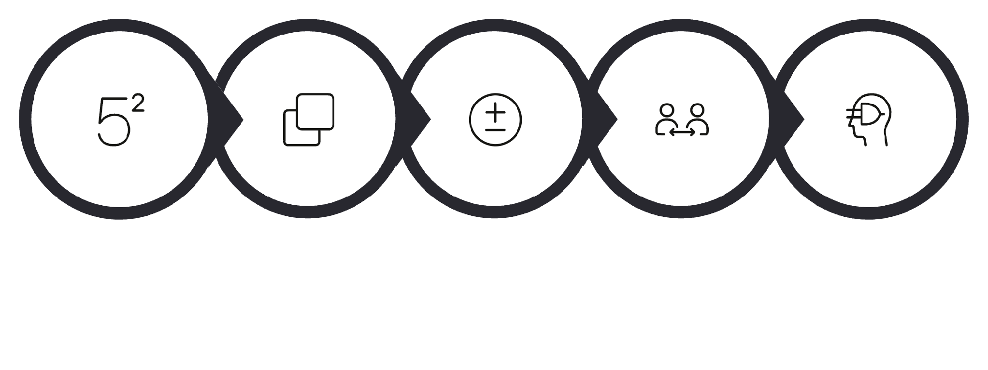

Operator Precedence
When multiple operators appear in one expression, Python follows a strict order — like PEMDAS in math. Use () to override the default order.
Examples
# Without parentheses:
2 + 3 * 4 # 14
# (* before +)
# With parentheses:
(2 + 3) * 4 # 20
# (+ forced first)
# Complex expression:
10 - 2 ** 3 / 4
# = 10 - 8 / 4
# = 10 - 2.0
# = 8.0
Exponentiation
Multiplication
Add/Subtract
Comparisons
Logical
Higher steps are evaluated first. Parentheses always take top priority.
When in doubt, add parentheses — they make your intent clear and prevent subtle bugs.

Slide 10




Common Beginner Mistakes
= vs ==
is vs ==
= assigns a value; == compares. Mixing them causes errors.
is checks identity, not equality — objects can be equal but not identical.
# WRONG:
if x = 5: # SyntaxError!
# CORRECT:
if x == 5: # Works!
a = [1, 2]
b = [1, 2]
a == b # True ✓
a is b # False ✗
/ vs //
Choose the right division operator for your use case.
7 / 2 # 3.5 (float)
7 // 2 # 3 (integer)
# Use // when you need
# a whole number result

Slide 11

Practice: Put It All Together
Try these hands-on exercises to reinforce what you've learned about Python operators.
1
Even or Odd Checker
2
Login Validator
3
Letter Finder
Write a program that checks if a number is even using the modulus operator %.
Use and / or to validate a login: username exists and password is correct.
Try in to search for a letter in a word entered by the user.
word = input("Enter a word: ")
letter = input("Search for a letter: ")
if letter in word:
print(f"'{letter}' found in '{word}'!")
else:
print("Not found.")
num = int(input("Enter a number: "))
if num % 2 == 0:
print("Even!")
else:
print("Odd!")
username = "admin"
password = "1234"
if username == "admin" and password == "1234":
print("Access granted!")
else:
print("Access denied.")
You've covered all 7 Python operator types! Keep experimenting in the Python console — practice is the fastest path to mastery. 🐍

